Slide 1
Project - Let’s Play FIFA!
Vivek H. Nariya
E karthik Sai
Manendra pal singh
Kaushal ramdeo

Slide 2
Table of Contents
Problem Statement
Methodology
Part A – Predict Player Rating
Part B – Predict Player Position
Part C – Rank the best staff
Drawbacks and Next Steps

Slide 3
Problem statement :
ID | Problem Statement | Approach | Training Data | Test Data | Evaluation Criteria
Part A | Predict Player Rank | Regression Model | 2019 Data | 2020 - Select Clubs | MSE for player rating
Part B | Predict Player Position | Classification Model | 2019 Data | 2020 – Select Clubs | Classification Accuracy (If the predicted position is one of the actual player positions it is classified correctly)
Part C | Rank the best staff | No Model - Rank the clubs based on growth of the players | 2015-2020 Data | - | We have used corresponding salary growth of the player to see if the club has improved the players are not

Slide 4
Things that We Used
Language Used | Python
Key Packages Used | Data Handling - Pandas, Numpy Modelling – sklearn, Visualization – Seaborn, Matplotlib
Key Data Used | Skill Details Performance details Characteristics

Slide 5
Part A
Train data :
2019 train on 80% of data
Data manipulation
KNN imputer to impute data
Label encoding
We Performed
Linear Regression, Cross validation (mse : 1.51)
LASSO (mse : 2.5)
Decisiontree (mse : 1.05)
Randomforest (mse : 0.42)
Adaboost (mse : 1.81)

Slide 6
Part B
Train data :
2019 train on 80% of data
Data manipulation
KNN imputer to impute data
Label encoding
We Performed
logistic Regression, Cross validation (accuracy : 71)
Decisiontree (accuracy : 59)
Randomforest (accuracy : 69)
Adaboost (accuracy : 45)

Slide 7
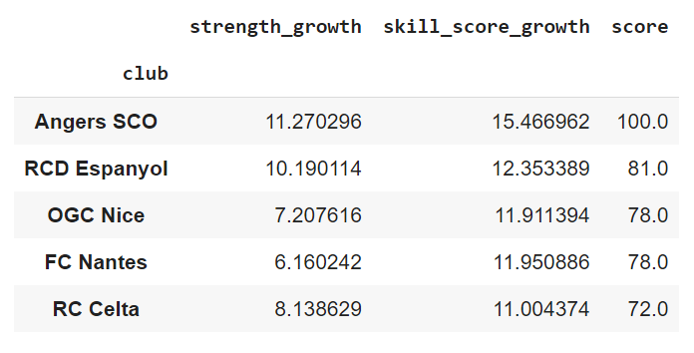
Part C:
We used potential and overall score to evaluate score

Slide 8
ID | Problem Statement | Result | Ideas to improve
Part A | Predict Player Rank | MSE – 1.92 | While we already predict the player rank with + or – 1 difference, there is still some improvement required w.r.t to the rank ordering of the results. Ranks sometime get shuffled. Creating more features, Training on older/2020 data could help.
Part B | Predict Player Position | Accuracy – 69 | Scope to predict all the player positions and not just 1. More features to distinguish among the player classes (e.g. LW is misclassified as RW). Focus on low volume positions’ misclassification rate
Part C | Rank the best staff | -- | Assumption is the player’s growth fully gets attributed to 2015 club. Ideally the growth should get attributed based on the time spent and if there was any growth during that time.

Slide 9
Thank You

